Slide 1
NODE JS
WEB ENGINEERING PROJECT
GROUP MEMBERS:
Shahar Yar (18-ARID-3084 MCS-3)
Talha Sarwar (18-ARID-3089 MCS-3)

Slide 2
We will discuss,
What is NODE JS?
Why is NODE JS?
What is the purpose of NODE JS?
installation of NODE JS
Examples of NODE JS

Slide 3
What is NODE JS
Its NOT a web framework, and its also NOT a language
“A RUN TIME ENVIORMENT TO EXECUTE JAVA SCRIPT CODE”
Node.js is an open source,
cross-platform runtime environment,
for developing server-side and networking applications.
Node.js applications are written in JavaScript, and can be run within the Node.js runtime on OS X, Microsoft Windows, and Linux.

Slide 4
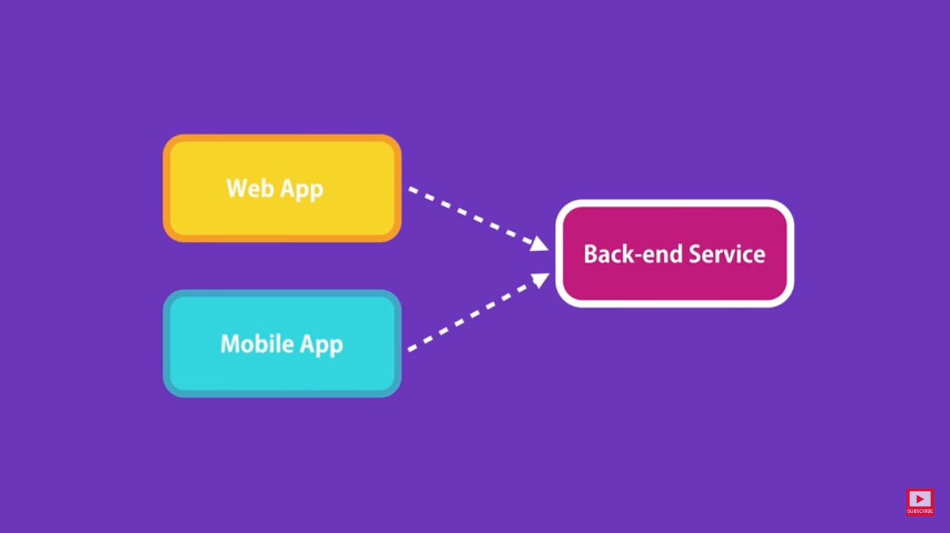
They need to talk to some one sitting on the server/cloud to send data ,email or push notification

Slide 5
Why we use NODE JS
For High throughput
For Horizontal scalability [is about duplicating your application instance to manage a larger number of incoming connections]
For Evented model [to model, develop, validate, maintain, and implement event-driven applications targeted at business people]
For JavaScript for web, network, console[Front & Back End]
Includes Node Package Manager [Eco system library]

Slide 6
What is the Purpose of NODE JS
We use it to build the following,
API
Data Streaming Applications
Web Applications
Real-time applications
Event-based web sites
iOS/Android
Desktop Applications
Linux/Windows/OS X

Slide 7

Real world Example

Slide 8
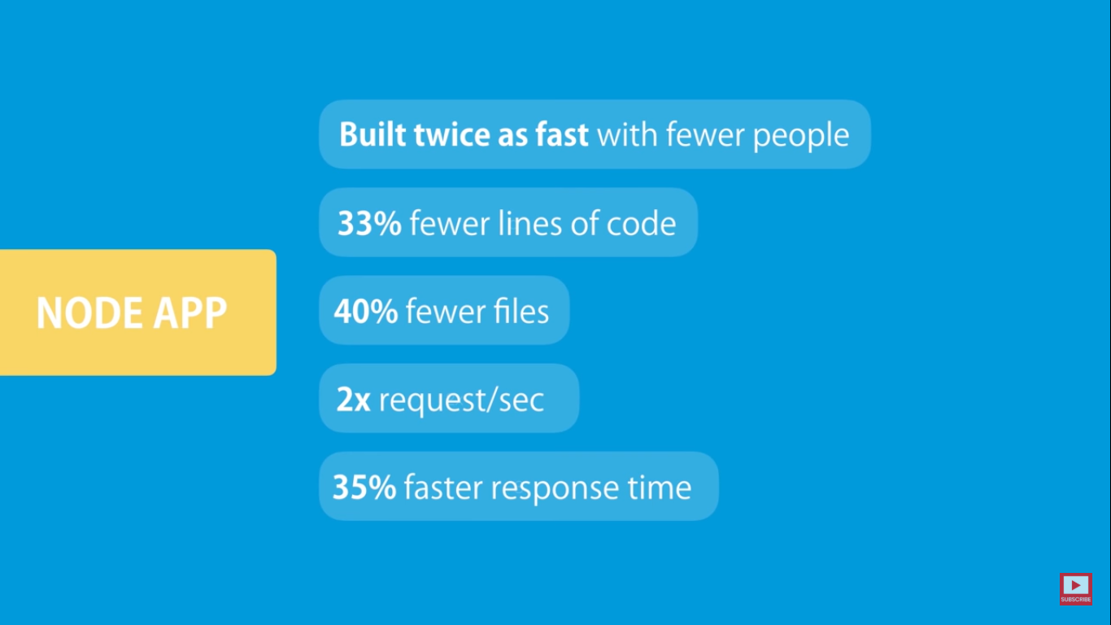
Results

Slide 9
Installation
Download node from https://nodejs.org/en/download/
Install .exe file
Open Node js Application
require directive to load Node.js modules
Read request and return response

Slide 10
Examples
Simple “Hello World”:
console.log(“Hello, World!”);
Web Page “Hello World”
var http = require('http');
http.createServer(function (request, response) { response.writeHead(200, {"Content-Type": "text/plain"}); response.end("Hello, World!\n");
}).listen(8000);
console.log("Server running at http://127.0.0.1:8000/");

Slide 11
Example
MYSQL Connection
var express=require('express');
var mysql=require('mysql');
var app=express();
const bodyParser=require("body-parser");
const path=require('path');
app.use(bodyParser.urlencoded({extended:false}));
app.get('/',function(req,res){
res.sendFile(path.join(__dirname +'/Document1.html'));
});

Slide 12
app.post('/search',function(req,resp){
var connection=mysql.createConnection({
host:'localhost',
user:'root',
password:'',
database:'Web Designers'
});
connection.connect(function(error){
if(!!error){
console.log('Error');
}
else{
console.log('Connected');
}
});

Slide 13
let identity=req.body.name;
connection.query("Select * from tblweb where ID="+parseInt(identity),function(error,rows,fields)
{if(!!error){
console.log('Error_2');
}
else{
console.log('SUCESS');
//resp.send(rows);
resp.send('You Searched '+ rows[0].Name+' having Phone Number '+rows[0].Phone_Number);
//console.log(rows[0]);
}
});
});app.listen(1337);

Slide 14


